Slide 1
WEKA PRESENTATION
Thang “Summer” Tran

Slide 2
Agenda
Diabetes Dataset
Using WEKA to do diabetes Analysis

Slide 3
What is Diabetes?
Diabetes is a chronic medical condition characterized by elevated blood sugar (glucose) levels.
It occurs when the body cannot produce enough insulin or effectively use the insulin it produces.

Slide 4
Types of Diabetes
Type 1 Diabetes:
Usually diagnosed in childhood or adolescence.
The immune system attacks and destroys insulin-producing cells in the pancreas.
Requires lifelong insulin injections or an insulin pump.
Type 2 Diabetes:
Often diagnosed in adulthood, but increasingly found in children and adolescents.
The body becomes resistant to insulin or doesn't produce enough.
Managed through lifestyle changes, oral medications, and, in some cases, insulin.
Gestational Diabetes:
Occurs during pregnancy and typically resolves after childbirth.
Women with gestational diabetes have a higher risk of developing Type 2 diabetes later in life.

Slide 5
Diabetes Dataset
Original owners: National Institute of Diabetes and Digestive and Kidney Diseases
Donor of the database: Vincent Sigillito, Applied Physics Laboratory, The Johns Hopkins University
Date received: 9 May 1990
Notes:
And all patients here are females at least 21 years old

Slide 6
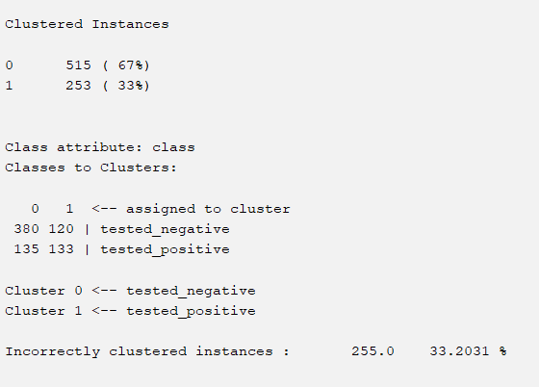
Using WEKA to do diabetes Analysis
SimpleKMeans
Notes:
While looking through the clustering models. There are 3 models that have lowest incorrectly clustered which are SimpleKMeans

Slide 7
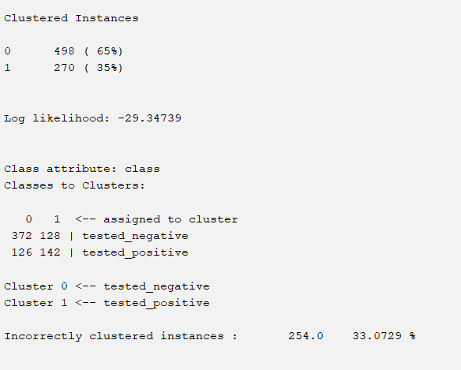
Using WEKA to do diabetes Analysis
MakeDensityBasedClusterer
Notes:
and MakeDensityBasedClusterer and Filtered Clusterer. Among that, Cobweb model seems like have the highest incorrectly clustered which is not good

Slide 8
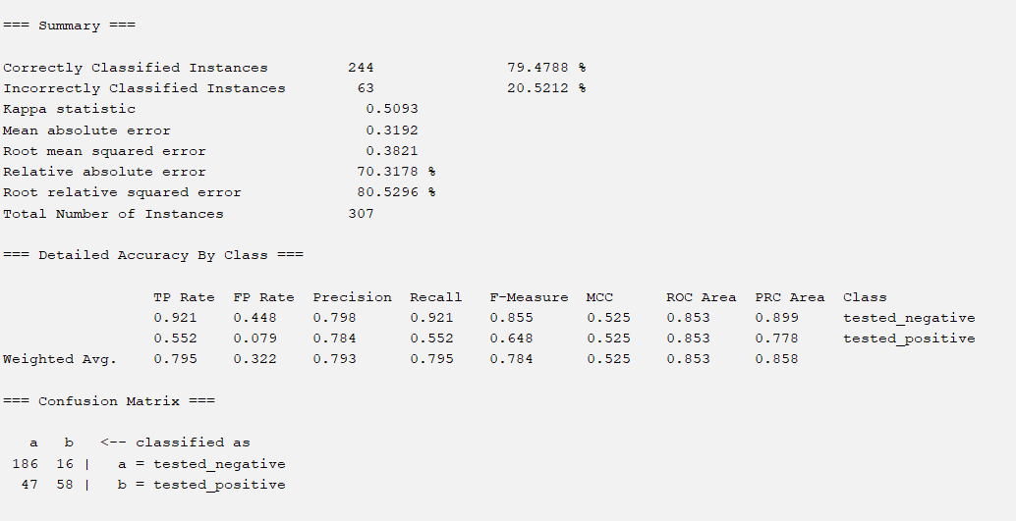
Training Data
Most Accurate: LMT and SimpleLogistic
79.4788 % Correctly
ROC Area is 0.853 which is good AUC

Slide 9
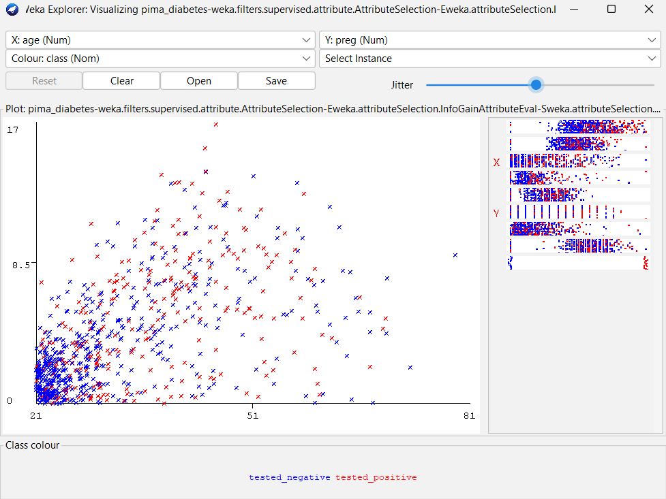
Relation between preg and Age
The percentage tested positive increased when the older got pregnant
Mostly higher chance for tested positive when pregnant after 30 years old

Slide 10
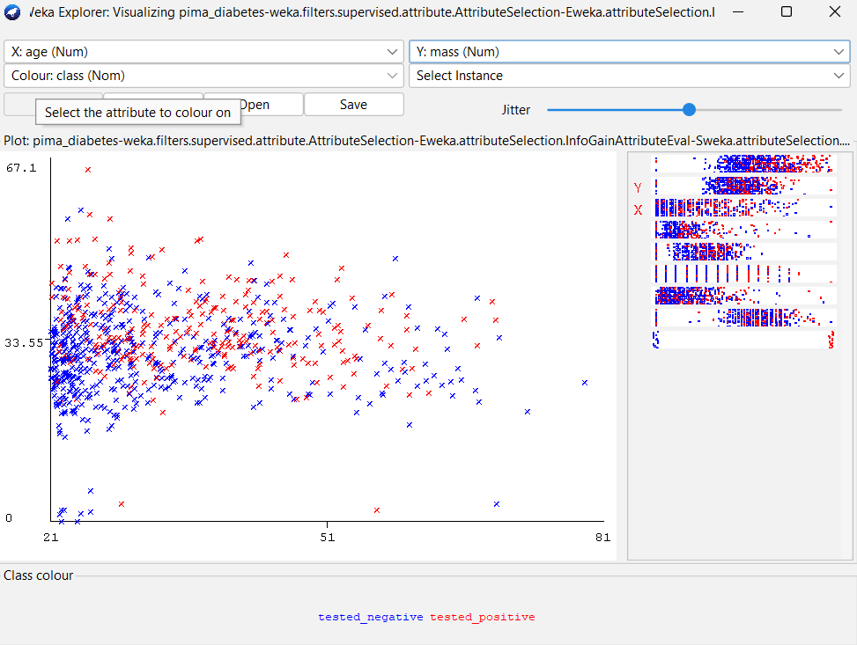
Relation between mass and age
Average weight is 33.55
People most likely tested positive with diabetes when they get older (30-50) or overweight

Slide 11

Thank you

